Slide 1

It talents
Season 13

Slide 2

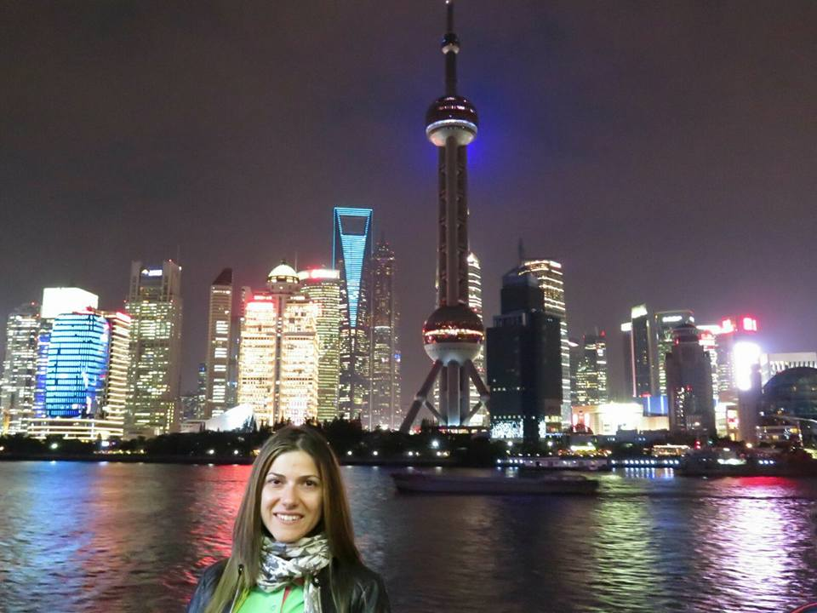

Denitsa Dochkova
EU projects expert
Travel lover
Desislava Gabrakova
Studying Graphic Design in
New Bulgarian University

Slide 3
Main functionality
Registration and login
Edit profile and change password
Buy ticket
Check free/occupied seats for a projection
Rate a movie
Get movie rating
Review cinemas and projections in them (optional filter city and/or projection type)
Admin profile for managing movies, cinemas, projections, halls, categories and types

Slide 4









What we used ?
Java17
Spring Boot
Spring MVC
MAVEN
Hibernate
JPA
MySQL
BCrypt
Lombok
Model Mapper
JDBC Template
InteliJ IDEA
Postman
GIT

Slide 5
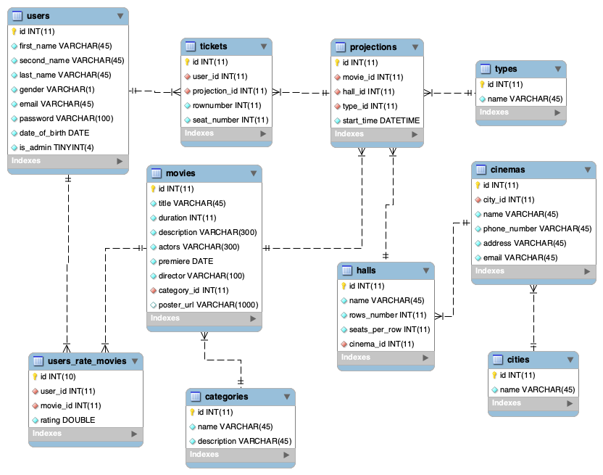
Database
diagram

Slide 6
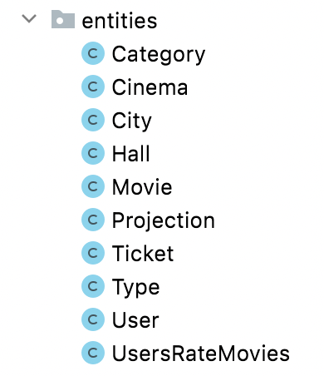
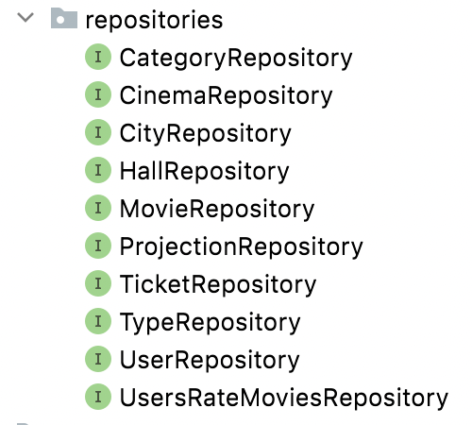
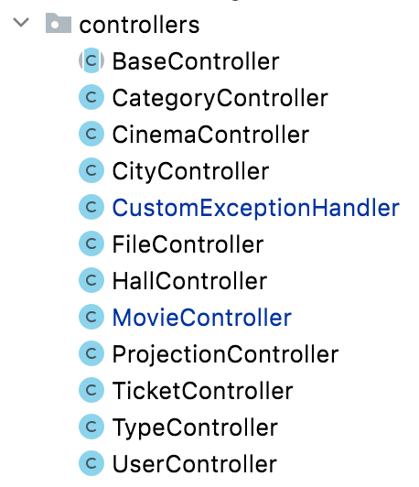
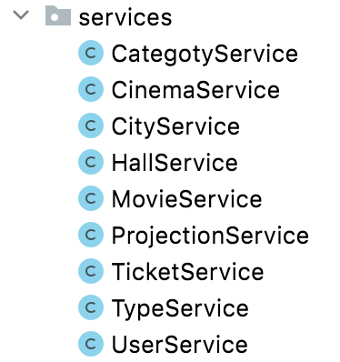
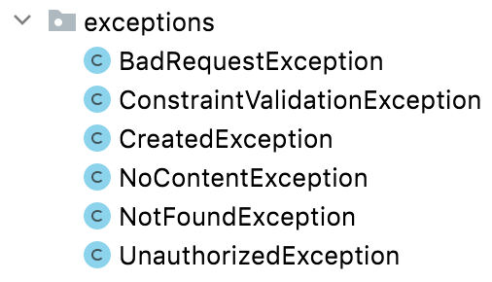
Class diagram

Slide 7
Demo

Slide 8

Questions?

Slide 9
Thank you!

